Slide 1


Arrays
Arrays a kind of data structure that can store a fixed-size sequential collection of elements of the same type.

Slide 2
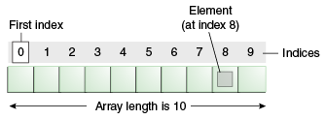

Structure

Slide 3

It is a programming concept.
One must solve questions to get it clear.
Introduction --
https://www.geeksforgeeks.org/introduction-to-arrays/

Slide 4

Practise Questions
https://www.geeksforgeeks.org/top-50-array-coding-problems-for-interviews/

Slide 5
2D Array
Array with one more dimension

Slide 6
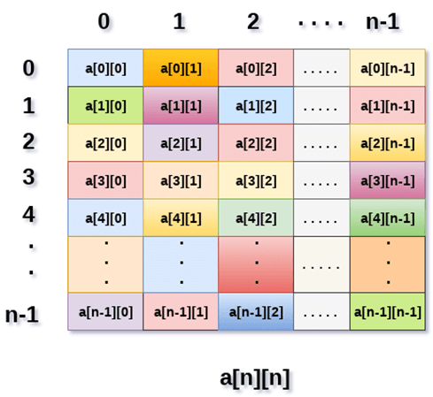
Structure

Slide 7

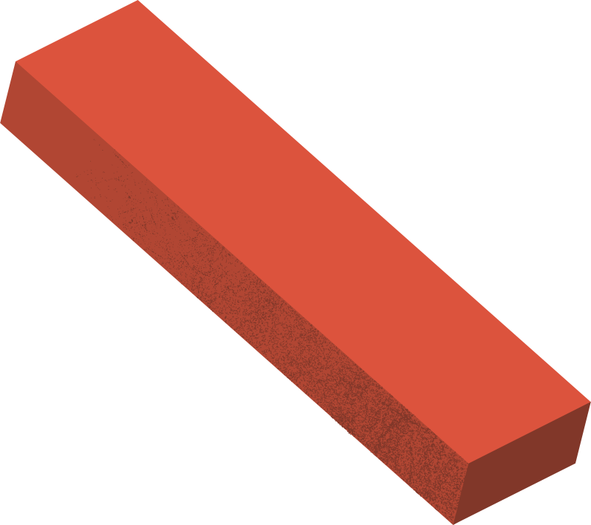
Practise Questions
http://www.cppforschool.com/assignment/array2_1.html

Slide 8
Sorting
Arranging elements in order

Slide 9
Insertion Sort
Types of Sorting
https://www.w3schools.in/data-structures-tutorial/sorting-techniques/insertion-sort-algorithm/
Bubble Sort
Selection Sort
https://www.w3schools.in/data-structures-tutorial/sorting-techniques/bubble-sort-algorithm/
https://www.w3schools.in/data-structures-tutorial/sorting-techniques/selection-sort-algorithm/
Merge Sort
Quick Sort
https://www.w3schools.in/data-structures-tutorial/sorting-techniques/merge-sort-algorithm/
https://www.w3schools.in/data-structures-tutorial/sorting-techniques/quick-sort-algorithm/

Slide 10
Practise Questions
https://www.fullstack.cafe/blog/sorting-algorithms-interview-questions

